Slide 2
SCRIPTURE
Devote yourselves to prayer with an alert mind and a thankful heart. ³ Pray for us, too, that God will give us many opportunities to speak about his mysterious plan concerning Christ. That is why I am here in chains. ⁴ Pray that I will proclaim this message as clearly as I should.
⁵ Live wisely among those who are not believers, and make the most of every opportunity. ⁶ Let your conversation be gracious and attractive [and seasoned with salt] so that you will have the right response for everyone.

Slide 3
OBSERVATION
1. Divine Opportunities
The Gospel spreads
Call to live in a new way

Slide 4
OBSERVATION
1. Divine Opportunities
Call for prayer
Persevere
Watchful
Thankful

Slide 5
OBSERVATION
1. Divine Opportunities
Talk about… the mystery and supremacy of Christ
(Col 1:15-20)
Call for tenacity

Slide 6
OBSERVATION
1. Divine Opportunities
Determined
Gracious
Attractive (above criticism)
Drawn to Christ
Tell our faith wisely

Slide 7
APPLICATION
1. Divine Opportunities
Every... | Is an opportunity for...
Circumstance or situation | God’s work in us; where Jesus can be glorified through us
Encounter | Christ seen in us as the hope of glory
Word | extending grace (‘a gentle answer deflects anger’ Proverbs 15:1)

Slide 8
SCRIPTURE
2. God’s Community
⁷ Tychicus will give you a full report about how I am getting along. He is a beloved brother and faithful helper who serves with me in the Lord’s work. ⁸ I have sent him to you for this very purpose—to let you know how we are doing and to encourage you. ⁹ I am also sending Onesimus, a faithful and beloved brother, one of your own people. He and Tychicus will tell you everything that’s happening here.

Slide 9
SCRIPTURE
2. God’s Community
¹⁰ Aristarchus, who is in prison with me, sends you his greetings, and so does Mark, Barnabas’s cousin. As you were instructed before, make Mark welcome if he comes your way.¹¹ Jesus (the one we call Justus) also sends his greetings. These are the only Jewish believers among my co-workers; they are working with me here for the Kingdom of God. And what a comfort they have been!

Slide 10
SCRIPTURE
2. God’s Community
¹² Epaphras, a member of your own fellowship and a servant of Christ Jesus, sends you his greetings. He always prays earnestly for you, asking God to make you strong and perfect, fully confident that you are following the whole will of God. ¹³ I can assure you that he prays hard for you and also for the believers in Laodicea and Hierapolis.
¹⁴ Luke, the beloved doctor, sends his greetings, and so does Demas. ¹⁵ Please give my greetings to our brothers and sisters at Laodicea, and to Nympha and the church that meets in her house.

Slide 11
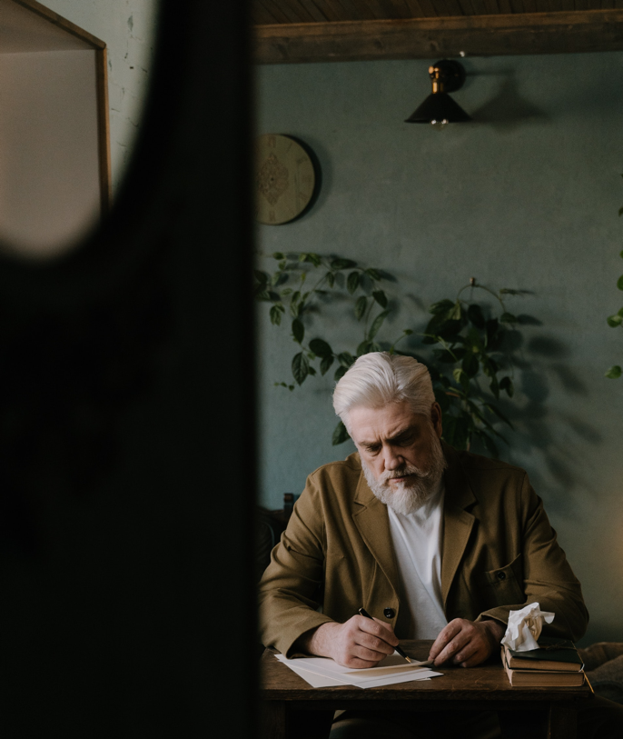
OBSERVATION
2. God’s Community
NT letters often closed with greetings from others
Sent out irregularly with travellers
Photo by cottonbro studio: www.pexels.com

Slide 12
OBSERVATION
2. God’s Community
TEAM BASED MINISTRY
Character of Christian community
Models an attitude of collegiality

Slide 13
Paul’s friends who were encouragers and companions
ONESIMUS
TYCHICUS
ARISTARCHUS
MARK
JUSTUS
NYMPHA and church in her home
EPAPHRAS
LUKE
Brothers & Sisters at Laodicea
DEMAS
ARCHIPUS

Slide 14
OBSERVATION
2. God’s Community
Jewish & Gentile co-labourers
Profound!
Universal character of early church

Slide 15
Colossians 4 | Philemon 23-24 | Romans 16:3-12 (people Paul wants greeted)
Tychicus Onesimus Aristarchus Mark Jesus Justus Epaphras Luke Demas Nympha Archippus | Epaphras Mark Aristarchus Demas Luke | Prisca [Priscilla] and Aquila (co-workers who risked their lives for Paul) Epenetus (first convert to Christ in the province of Asia) Mary (worked very hard in the Roman church) Andronicus and Junia (colleagues and fellow prisoners, well-known to the apostles) Ampliatus (friend in the Lord) Urbanus (fellow worker in Christ Stachys (good friend) Apelles (approved in Christ) Aristobulus’s household Herodion (colleague) Narcissus’s household Tryphena and Tryphosa, (labourers in the Lord) Persis (dear friend who worked hard in the Lord) Rufus (chosen in the Lord) and his mother (who was also a mother to Paul) Asyncritus, Phlegon, Hermes, Patrobas, Hermas, and the brothers and sisters with them Philologus and Julia, Nereus and his sister, and Olympas, and all the believers who are with them

Slide 16
SCRIPTURE
2. God’s Community
¹⁶ After you have read this letter, pass it on to the church at Laodicea so they can read it, too. And you should read the letter I wrote to them.
¹⁷ And say to Archippus, “Be sure to carry out the ministry the Lord gave you.”
¹⁸ HERE IS MY GREETING IN MY OWN HANDWRITING—PAUL.
Remember my chains.
May God’s grace be with you.

Slide 17

OBSERVATION
2. God’s Community
Pass the letter on
Signed off by Paul
Photo by Álvaro Serrano on Unsplash

Slide 18
APPLICATION
2. God’s Community
Evidence of Community
Relationship
Commitment
Evidence of Grace
Reconciliation
Restoration

Slide 19
PRAYER
Talk to God about what we’ve read
Confess sins brought to light and ask for God’s forgiveness
Ask God for guidance over what we’ve learned
Ask for grace and wisdom to make necessary changes because of what has been revealed

